Slide 1

How to Transform Jira
into a Project Tracker
  JOSE JIMENEZ| Atlassian Consultant | JOSE.JIMENEZ@DEISER.COM

Slide 2

Jira Projects pain points

Slide 3

PROFIELDS
Let’s face it, we all think Jira Project organization is a mess
(some people more than others…)

Slide 4

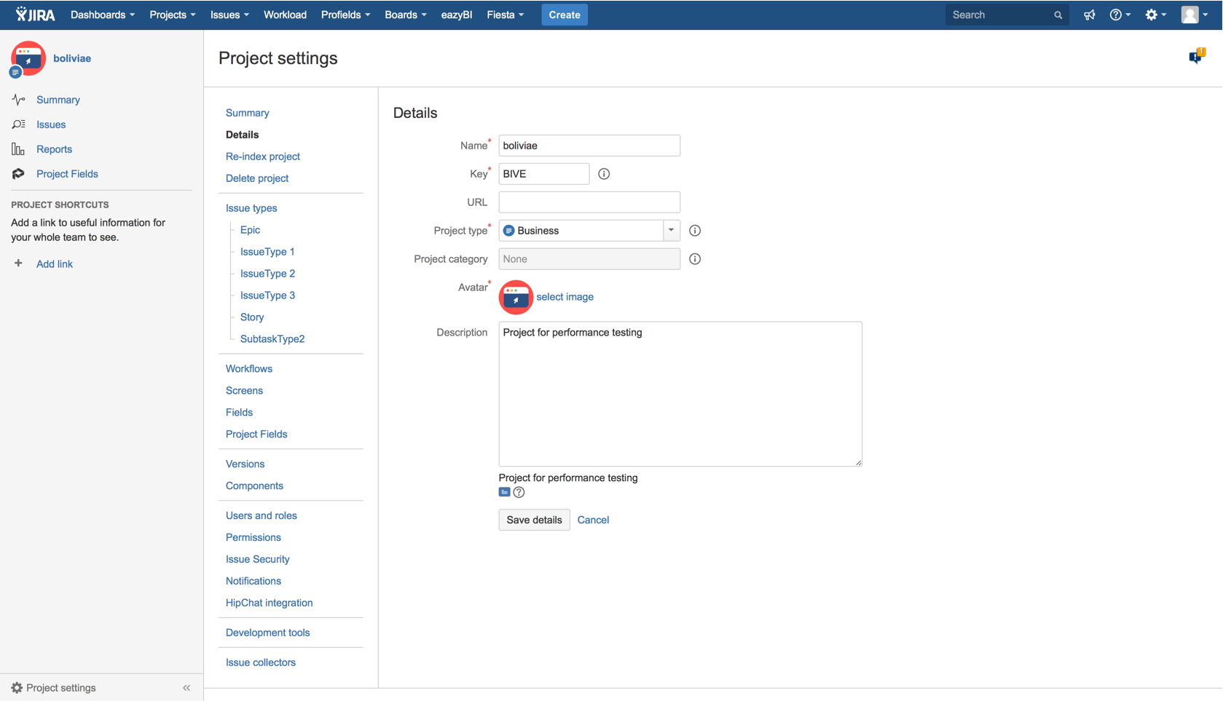
What needs do you need to cover?
Jira only has seven project-specific information fields.

Slide 5
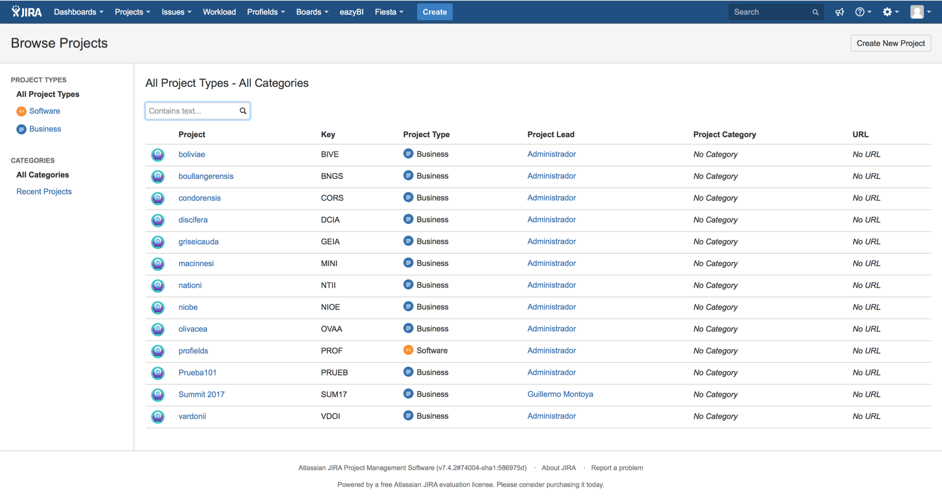
What needs do you need to cover?
Jira just has very basic project searching capabilities.
Jira just have very basic project searching capabilities.

Slide 6
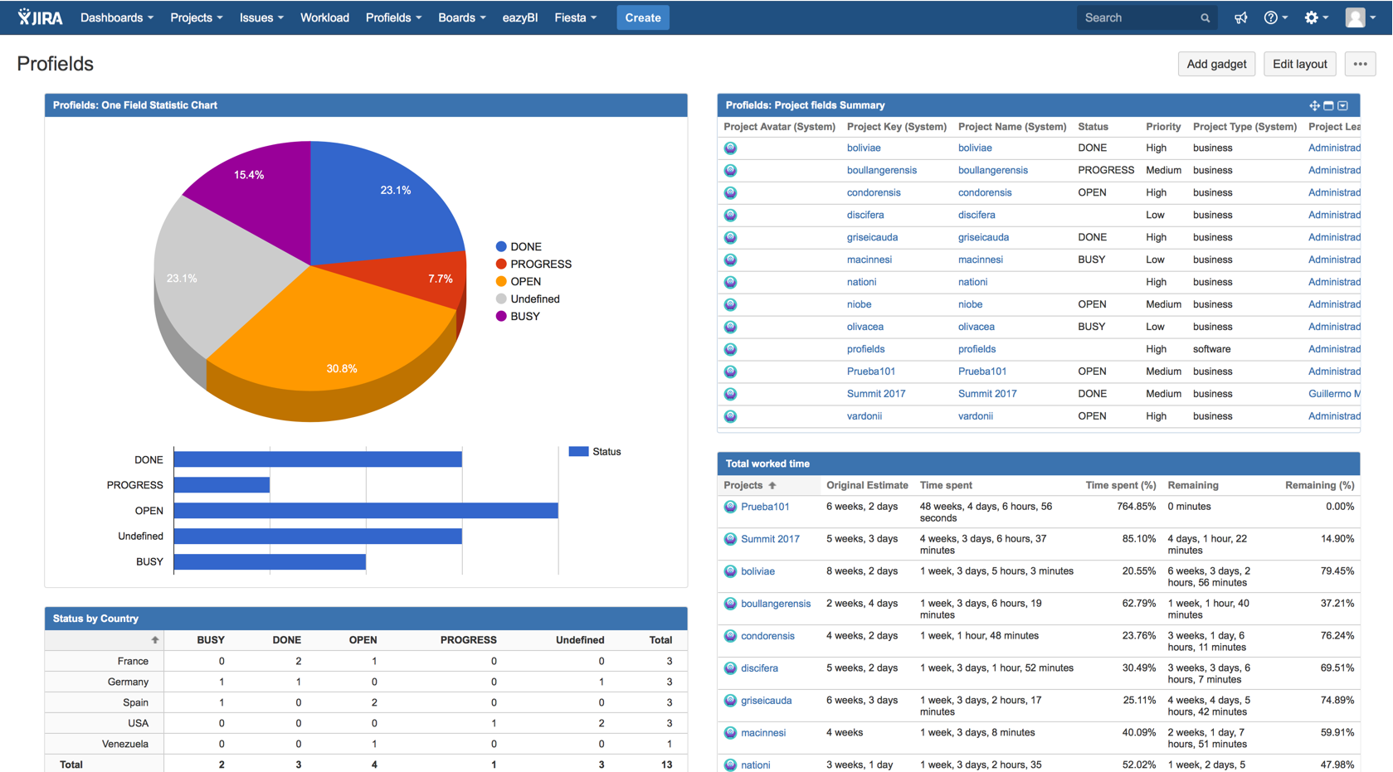
What needs do you need to cover?
Jira doesn’t have “project-specific information” based reports or gadgets.

Slide 7
When does an instance needs Profields?

Slide 8




Profields Main Features
Project Custom Fields
Multiple field types for JIRA Projects: List, Numeric, Status, Priority, Script and much more.
Calculated Fields
Aggregate the value of a single issue’s field in a Project. Perfect for having everything under control.
Project Navigator and Gadgets
Search and filter through JIRA Projects, and get useful Dashboard gadgets.
REST and Java API’s
Access and set Project Fields from third party software.

Slide 9

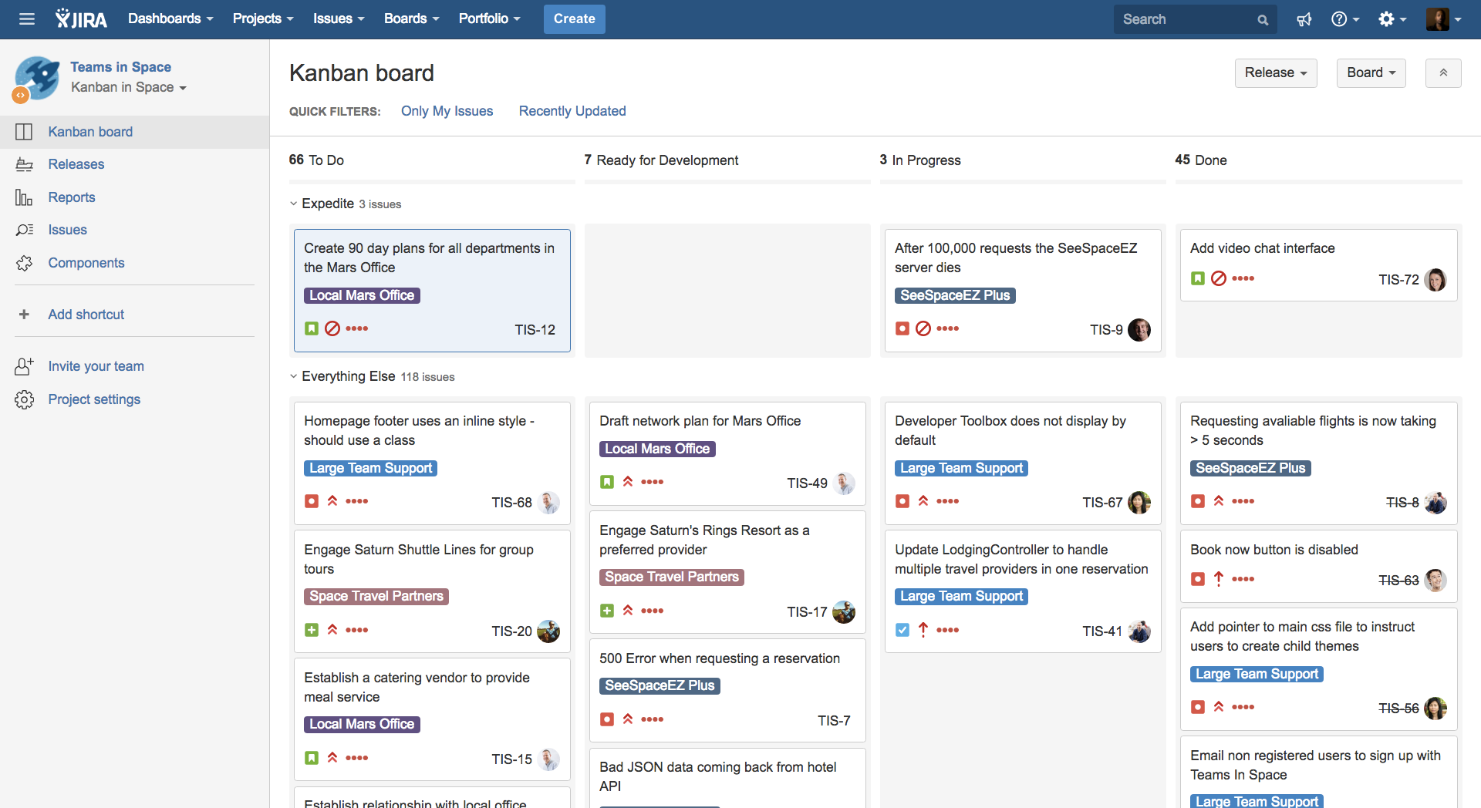
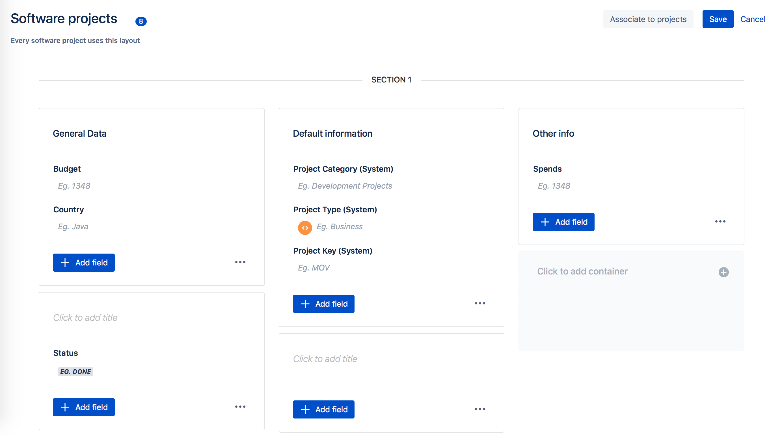
How does PROFIELDS Work?
Layouts
Organize and reuse fields across your projects
Project Navigator
Search and filter through JIRA Projects, and get useful Dashboard gadgets.
REST and Java API’s
Access and set Project Fields from third party software

Slide 10
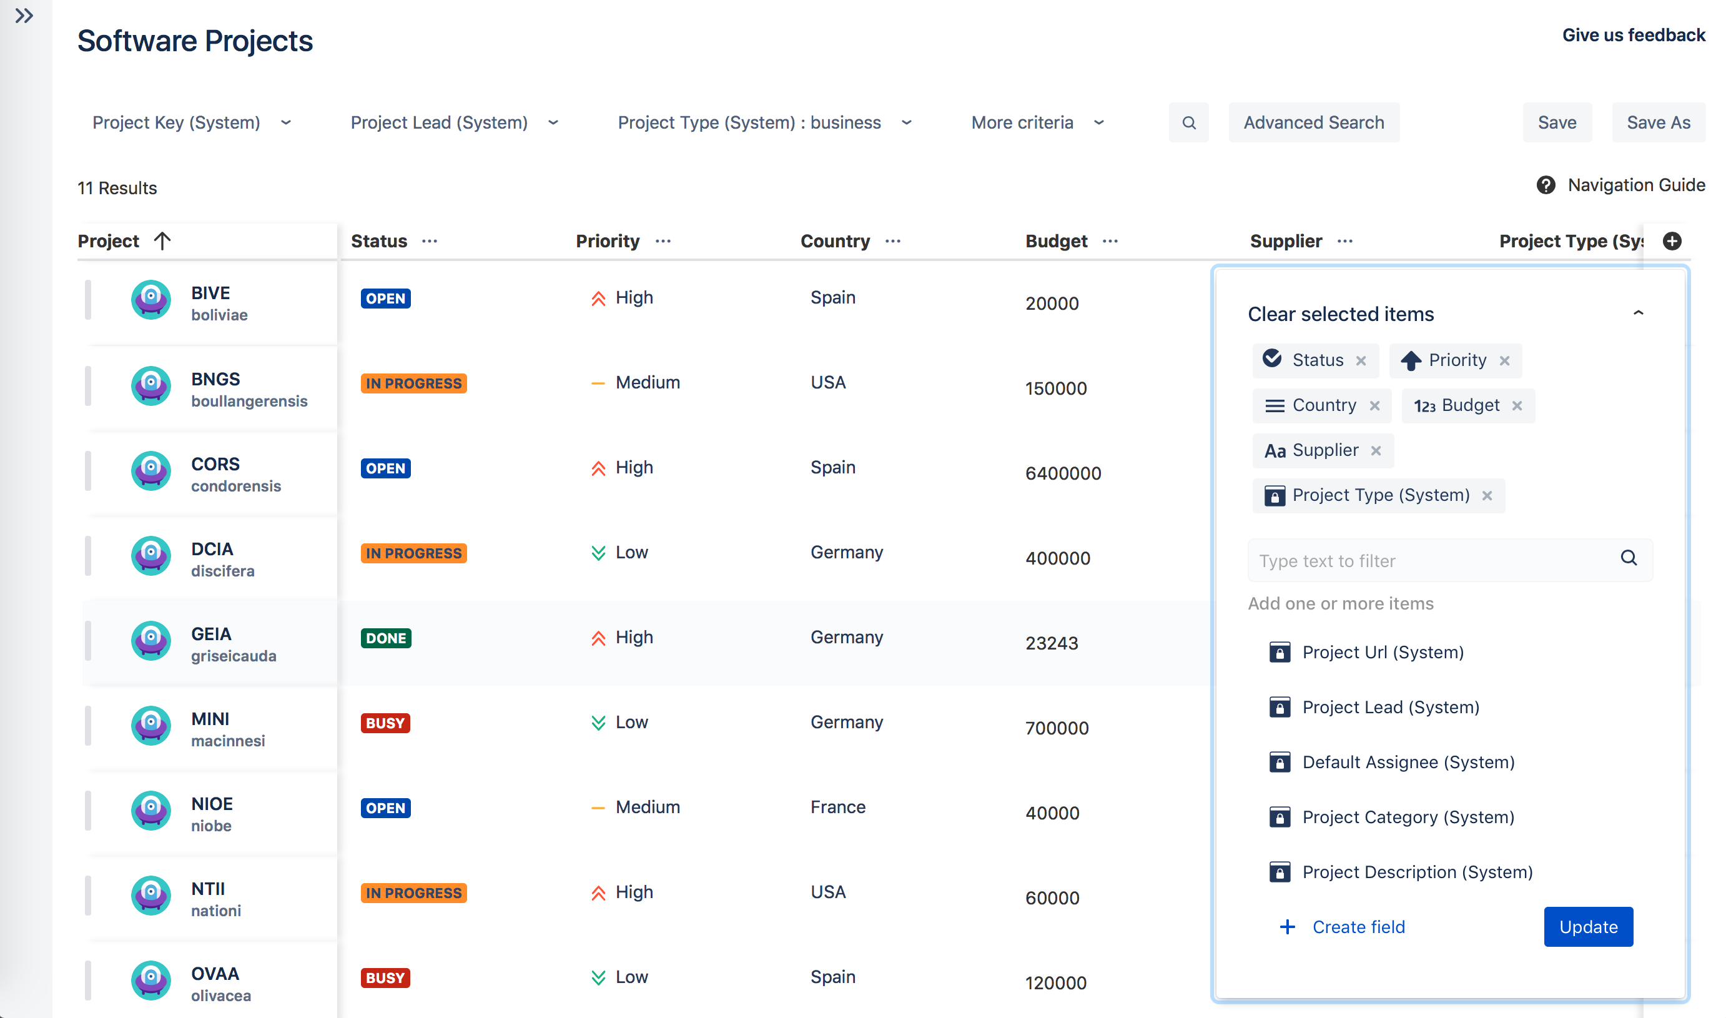
How PROFIELDS Works?
Layouts
Organize and reuse fields across your projects
Project Navigator
Search and filter through JIRA Projects, and get useful Dashboard gadgets.
REST and Java API’s
Access and set Project Fields from third party software

Slide 11
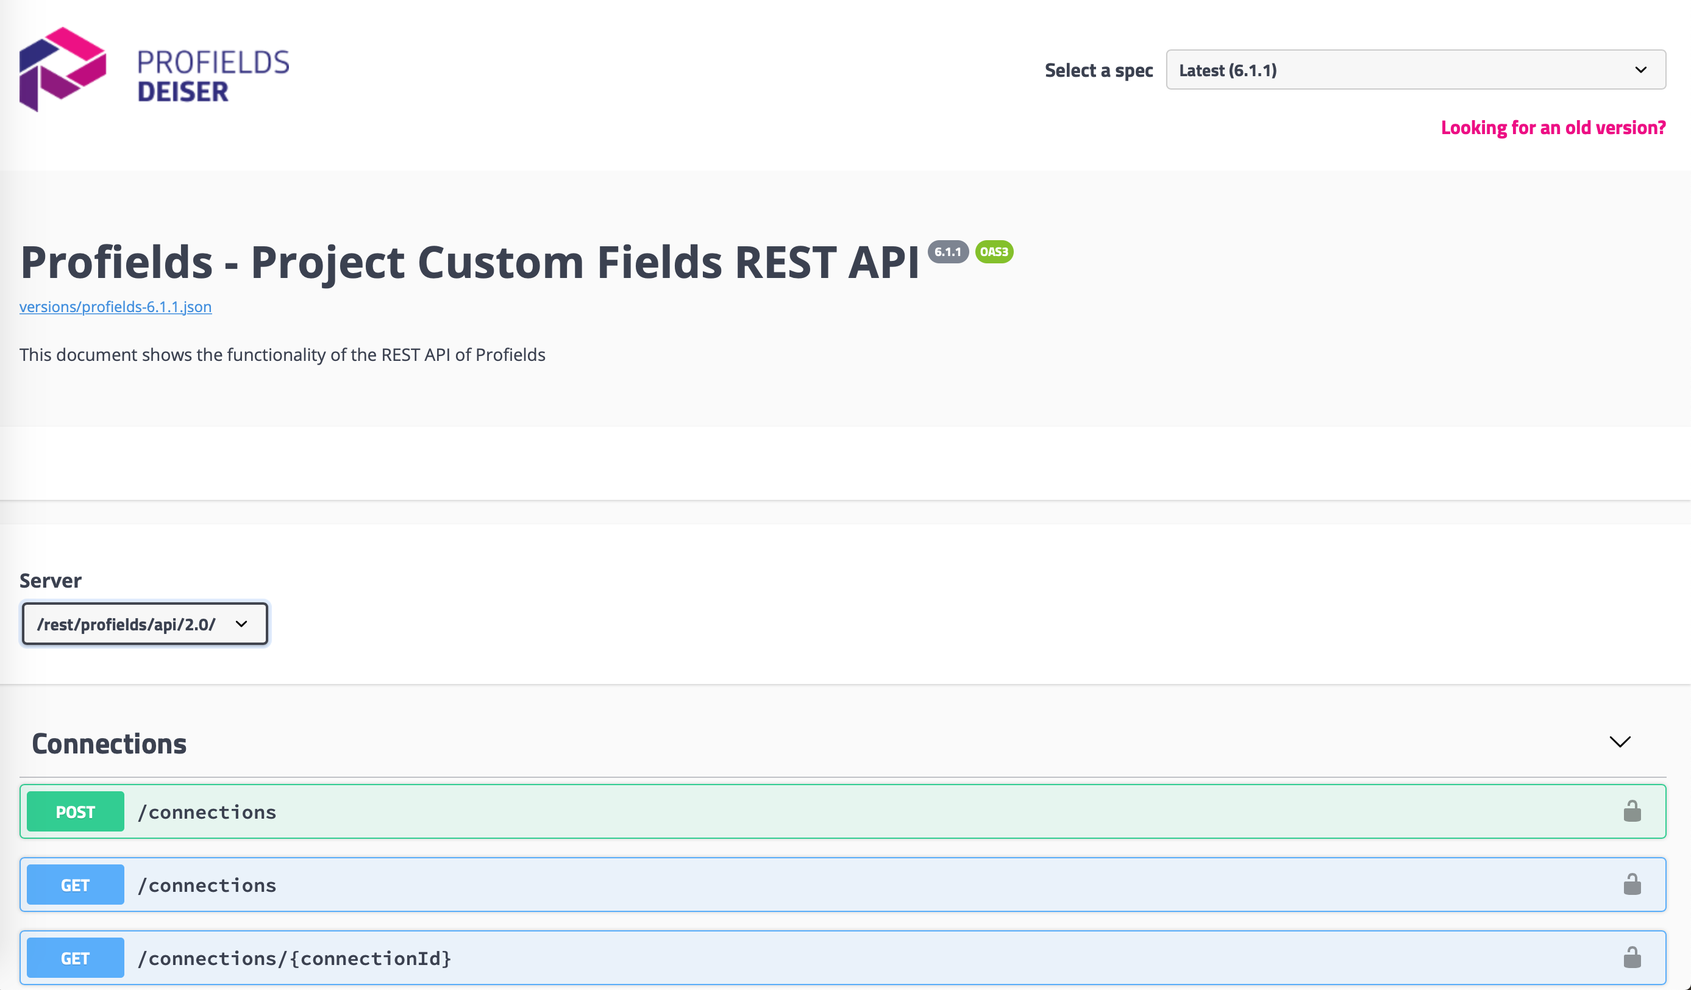
How PROFIELDS Works?
Layouts
Organize and reuse fields across your projects
Project Navigator
Search and filter through JIRA Projects, and get useful Dashboard gadgets.
REST and Java API’s
Access and set Project Fields from third party software

Slide 12

Use cases
How to keep track of budget and due dates.
Marcus is a Project Manager that needs to keep close his project’s in Jira without using another tool. Thanks to Profield’s Layouts, Custom Fields and Project Navigator, now it’s possible.
How to keep track of budget and due dates
How to track and automatically update support packs
How to improve your DevOps process

Slide 13
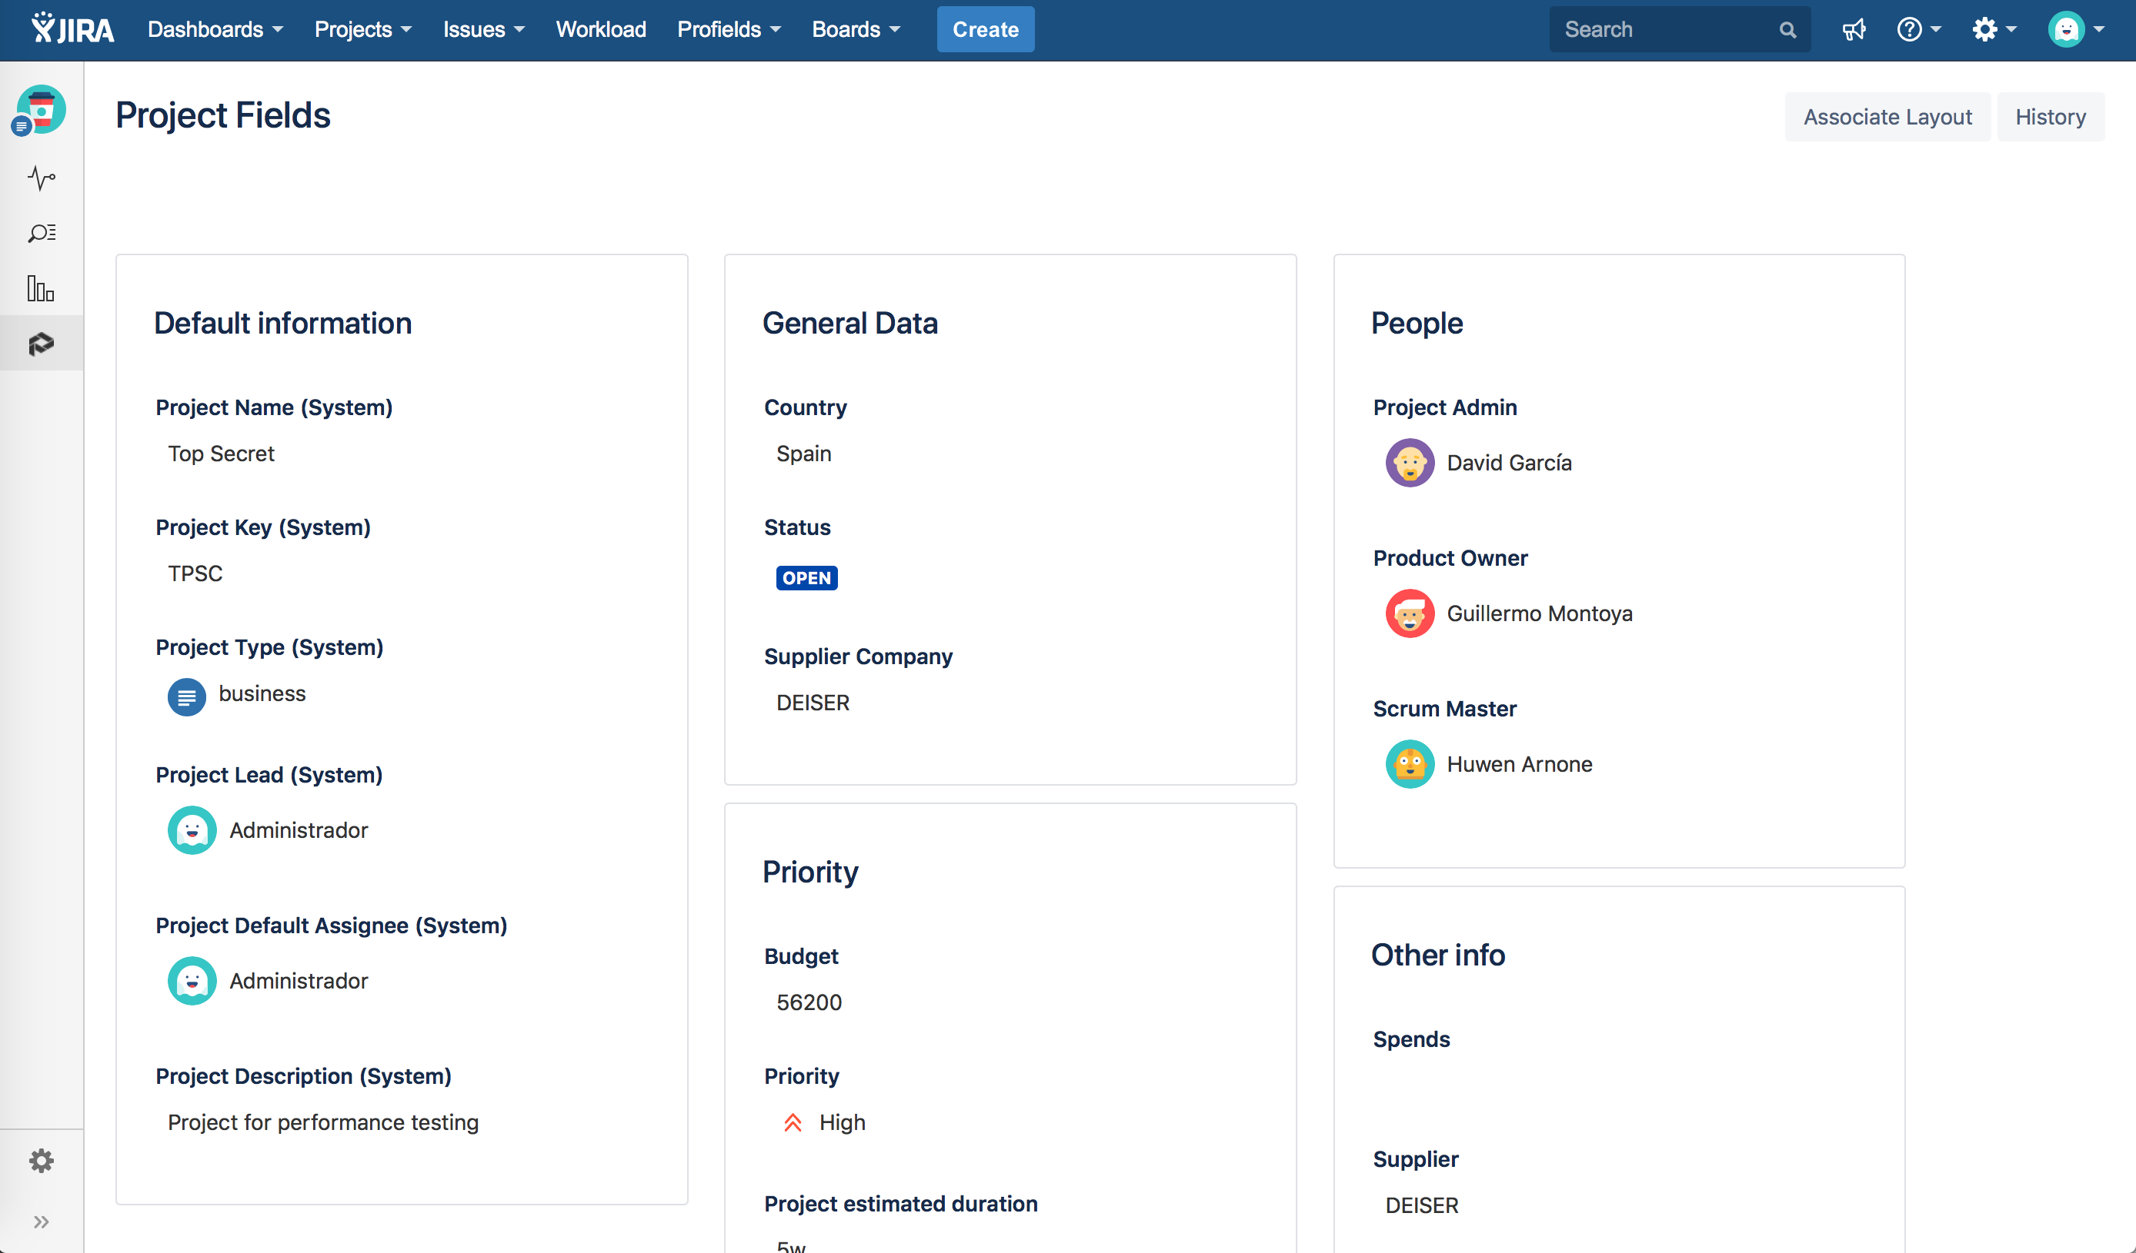
Use cases
How to keep track of budget and due dates
How to track and automatically update support packs
How to improve your DevOps process

Slide 14

Use cases
How to track and automatically update support packs
For better service performance, DEISER implemented Profields. Thanks to its calculated fields and script field type, our clients get a better support.
How to keep track of budget and due dates
How to track and automatically update support packs
How to improve your DevOps process

Slide 15
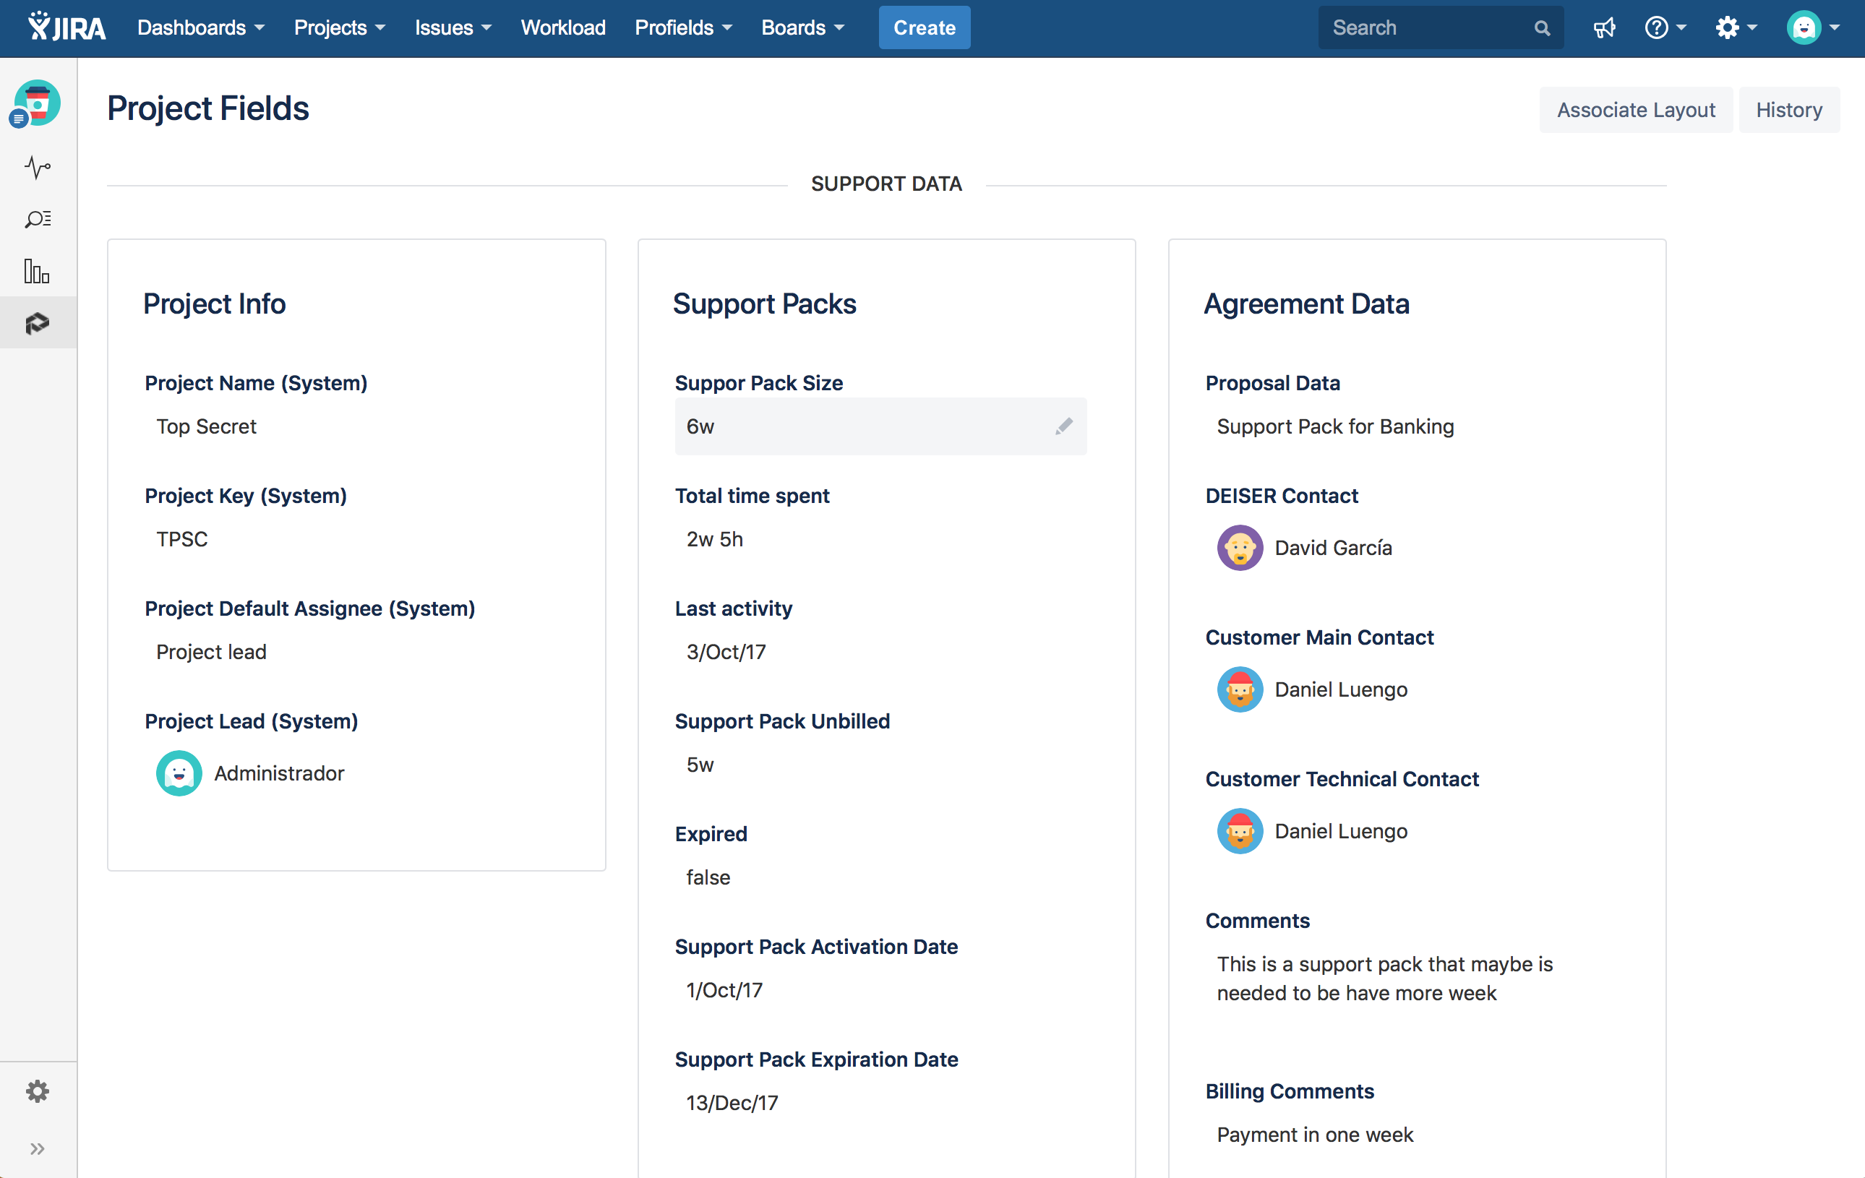
Use cases
How to keep track of budget and due dates
How to track and automatically update support packs
How to improve your DevOps process

Slide 16

Use cases
How to improve your DevOps process
The development team needs a place in Jira to store Bamboo and Confluence pages their different projects use. The Profields mapping to custom fields help them to access the Project Fields.
How to keep track of budget and due dates
How to track and automatically update support packs
How to improve your DevOps process

Slide 17
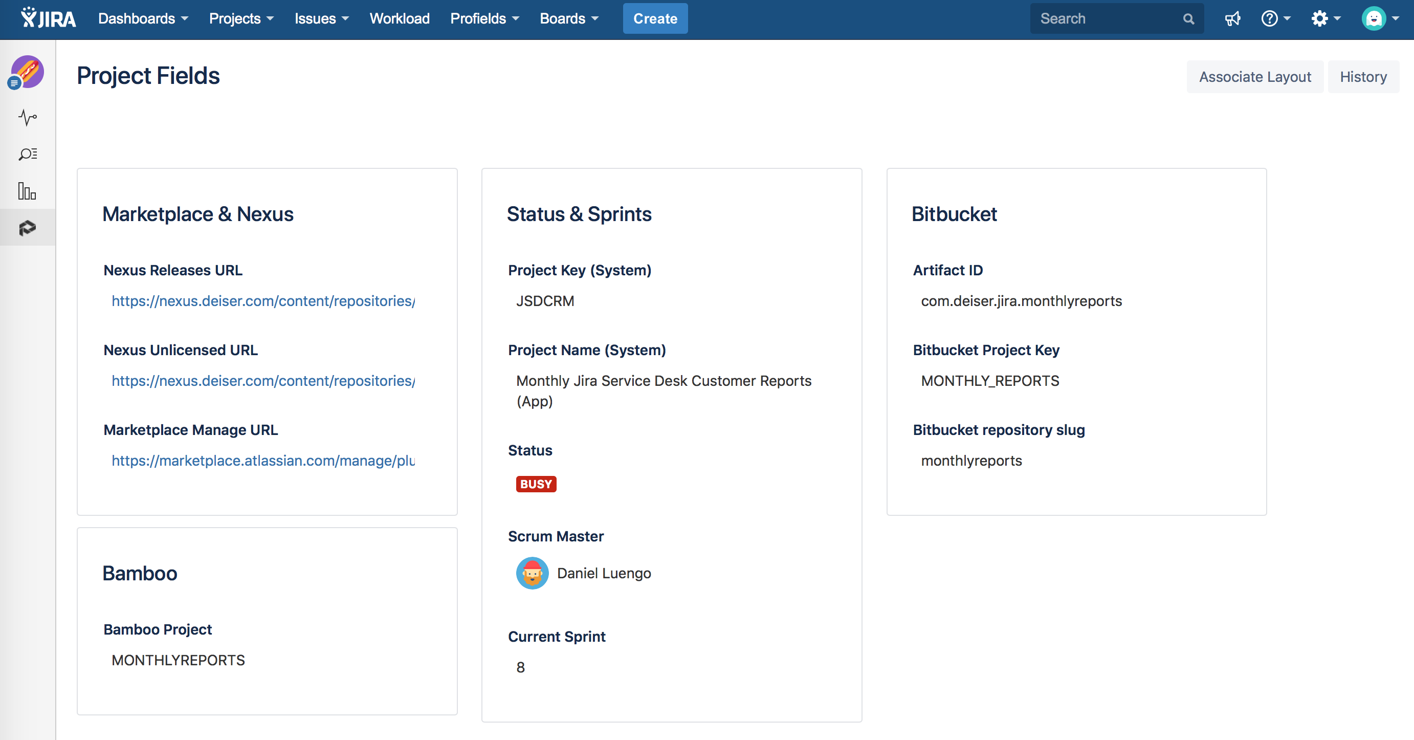
Use cases
How to keep track of budget and due dates
How to track and automatically update support packs
How to improve your DevOps process

Slide 18

Profields 6
Project Bulk Operations

Slide 19

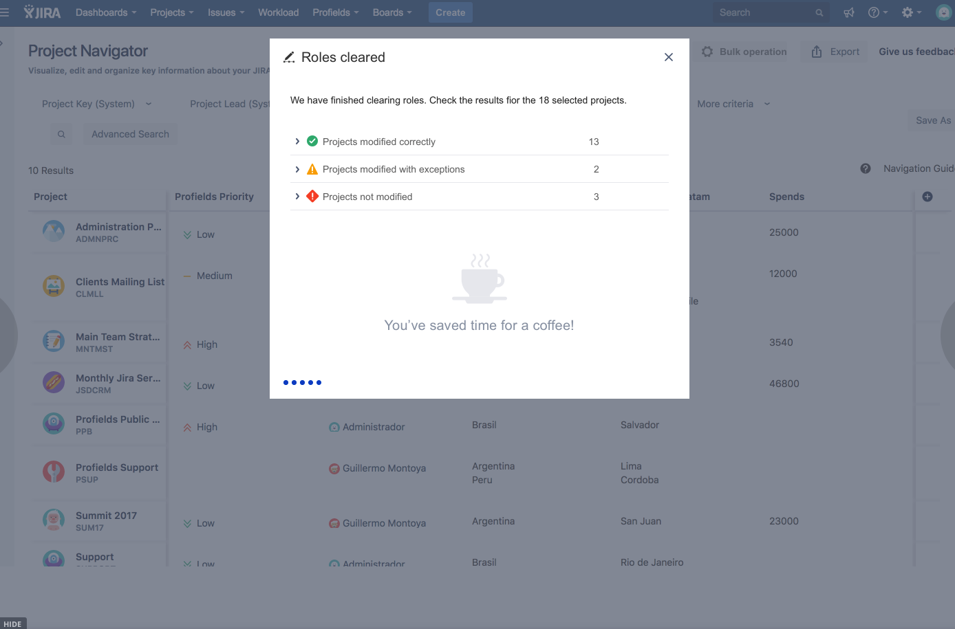

Slide 20
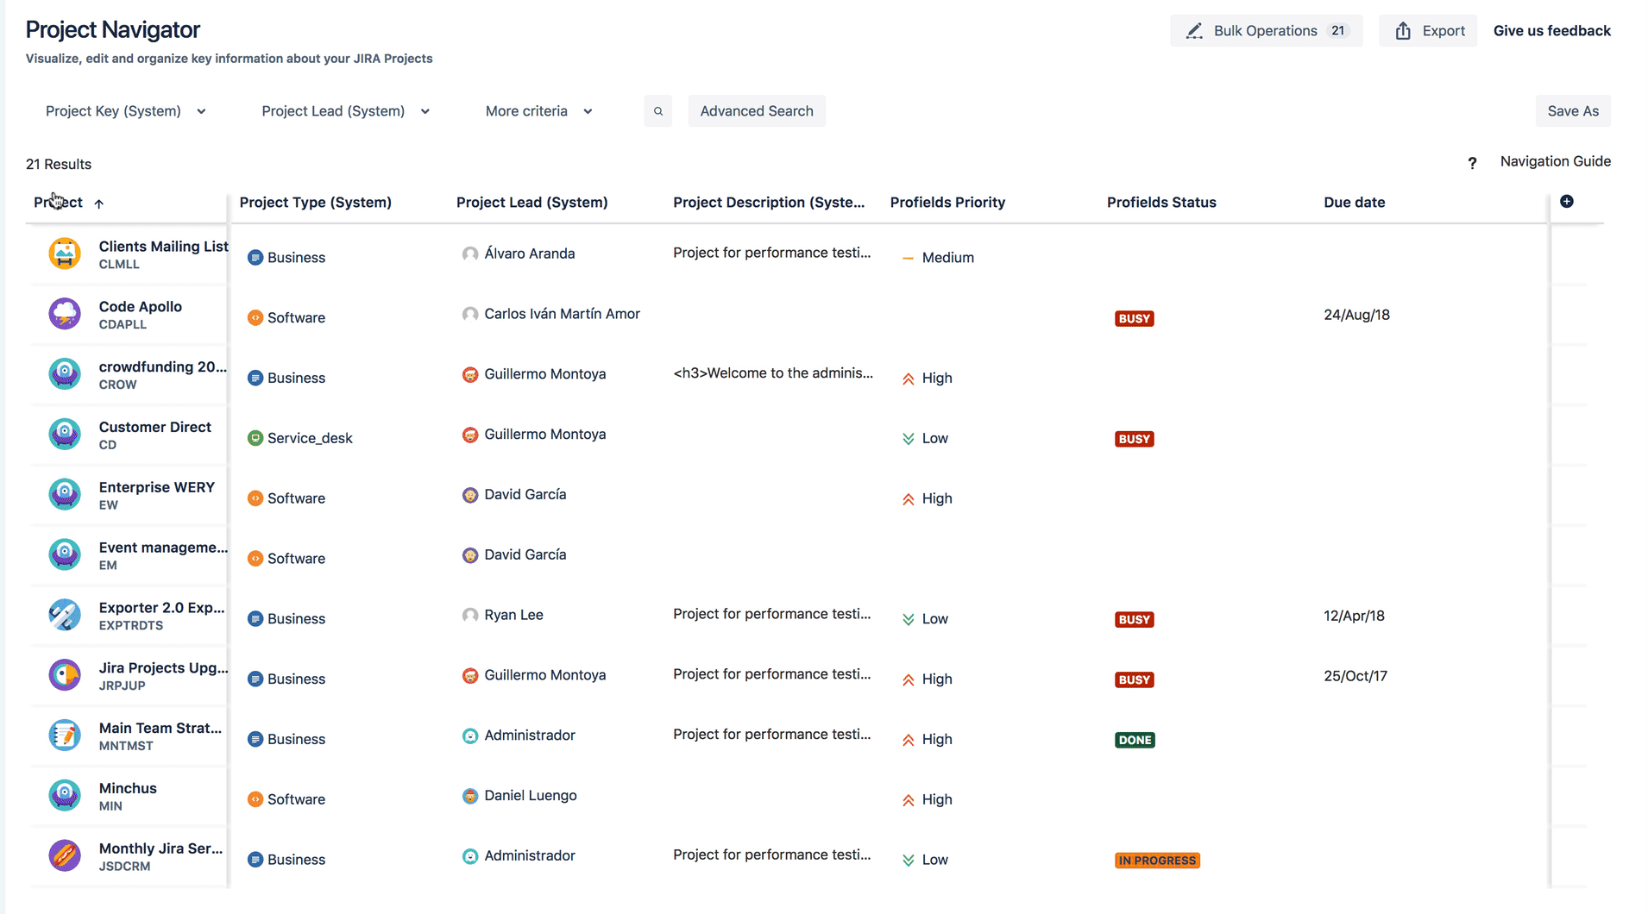
Notes:
A Project Lead in 50 Projects leaves the Company…

Slide 21
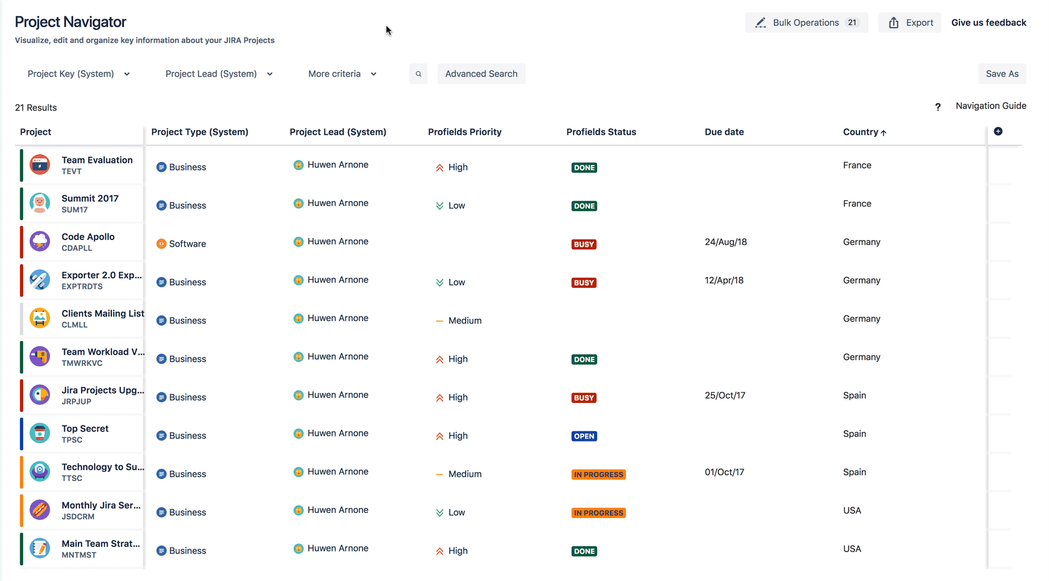
Notes:
I’ve made a training session and my Jira is full of unnecesary projects and schemes

Slide 22
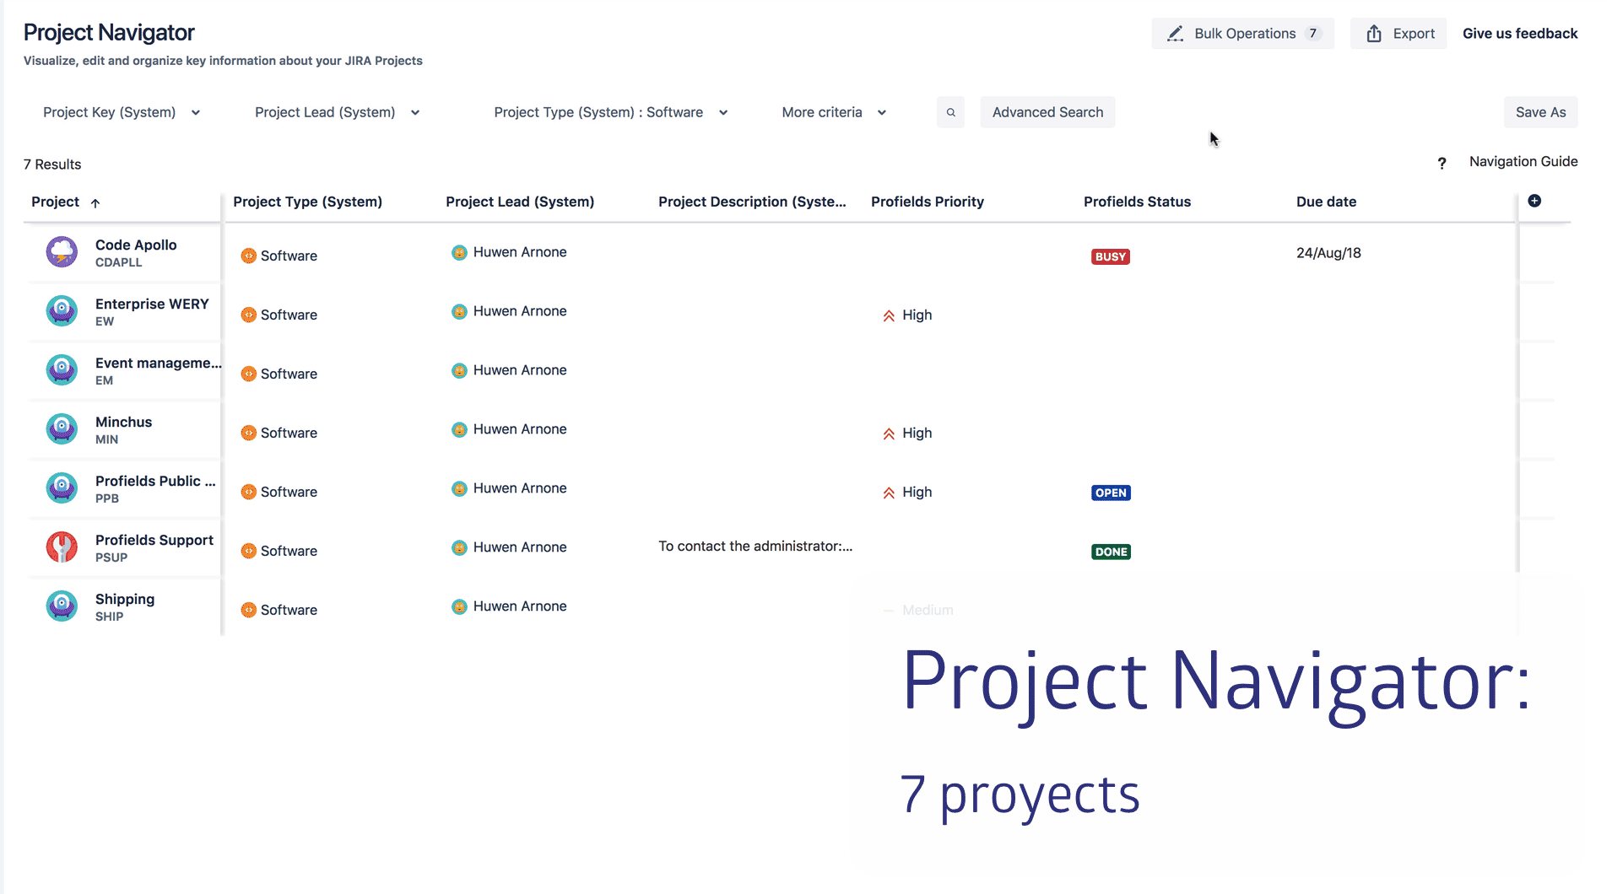
Notes:
I need to give permissions to a role in all projects…

Slide 23
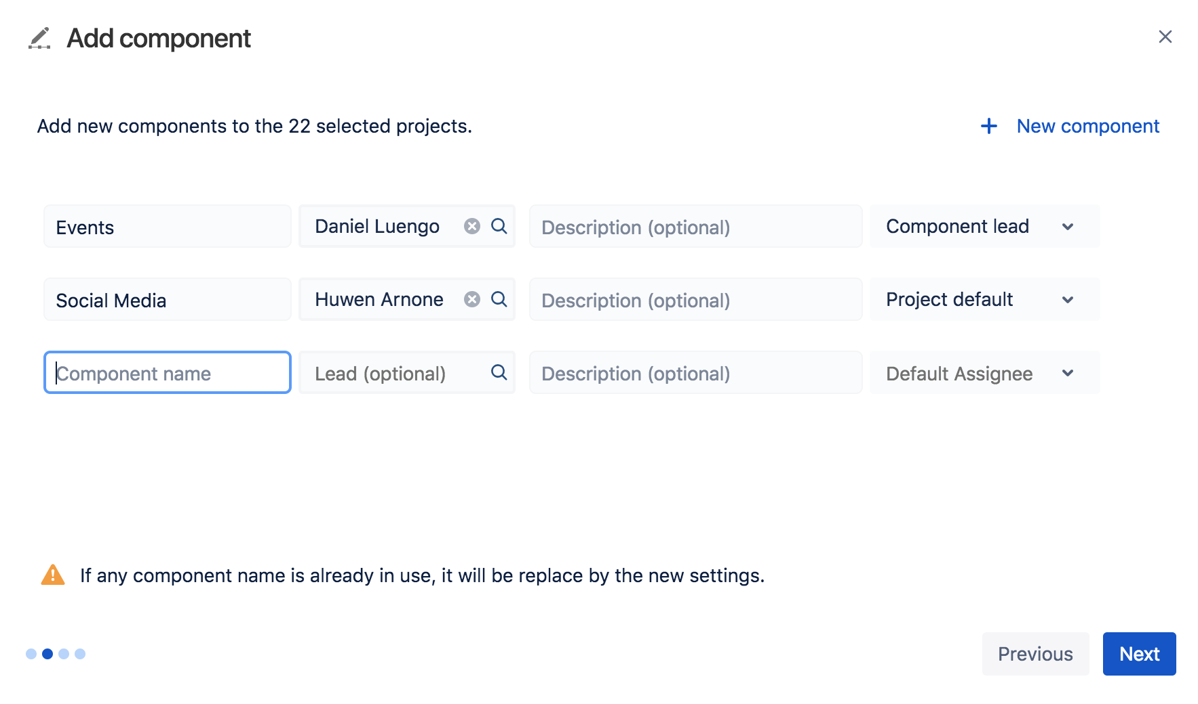
Notes:
I need to update the Components on 50 projects…

Slide 24







Operations Supported
Delete Projects
(and their schemes)
Roles
Project Lead
Project Fields
Category
Components
Layout

Slide 25
Demo

Slide 26
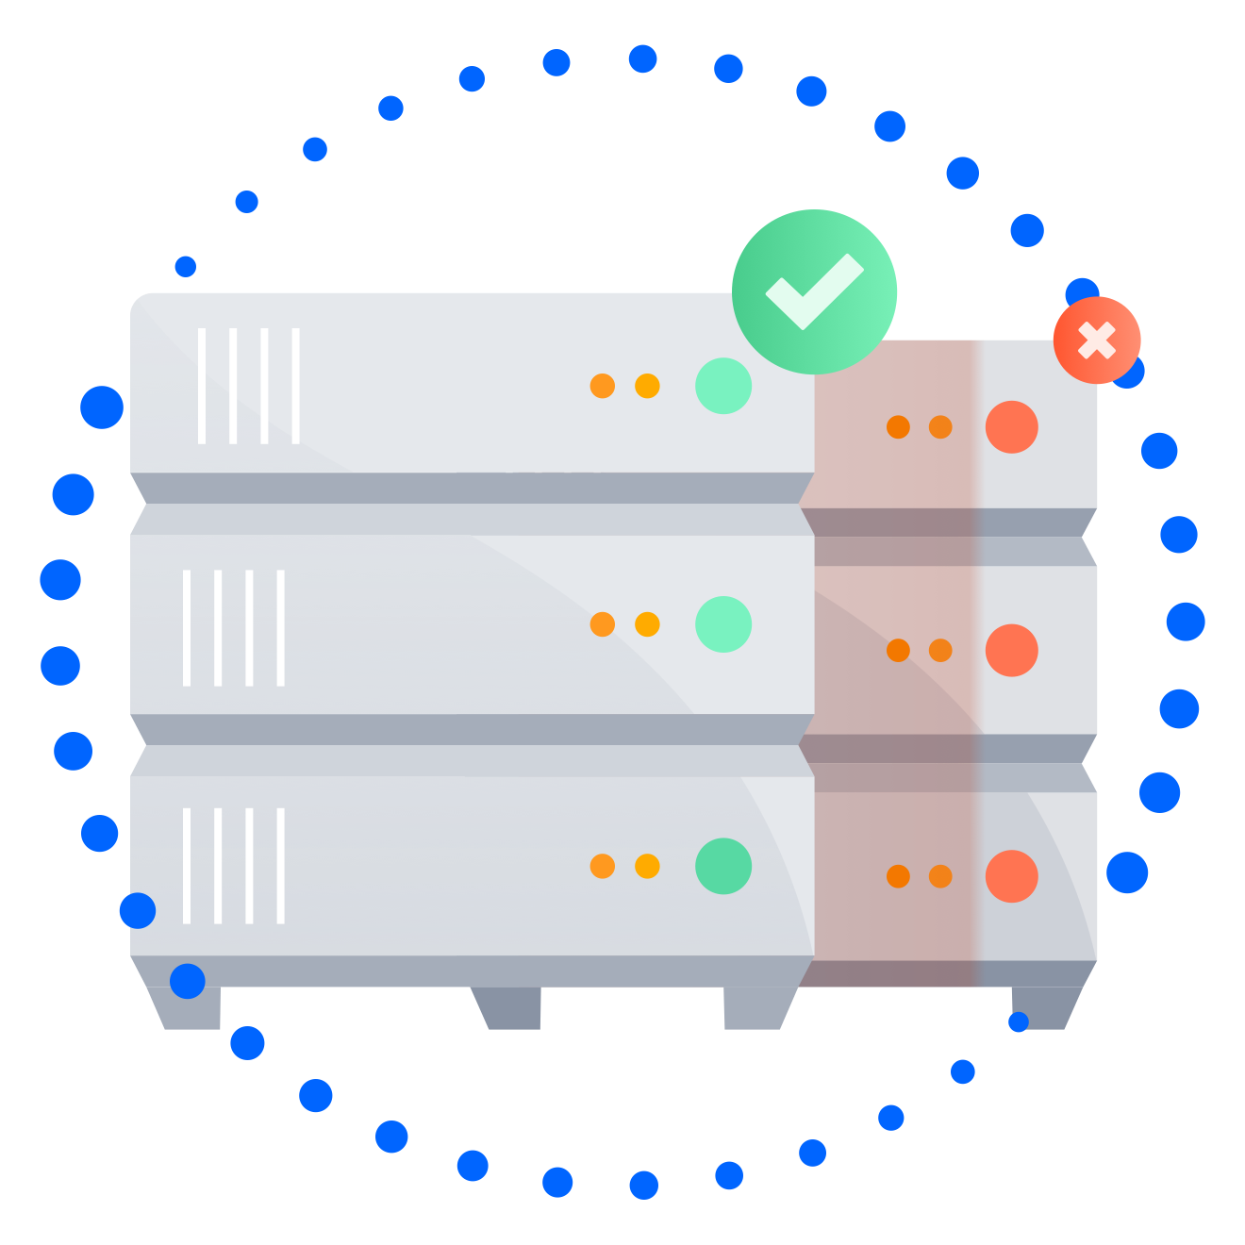
Available
Server
Data Center
New Atlassian Certification
Approved
Cloud
20% Partner Discount and Priority Support

Slide 27

HELP AND SUPPORT
jira.deiser.com/support
help@deiser.com

Slide 28

Stay tuned!
profields-backlog.deiser.com

Slide 29
Thank you!

